Slide 1
Cascading Style Sheets
(CSS - Basic)
Start Here

Slide 2

Prerequisites
Basic idea about web development
Knowledge about HTML
Basic concept/idea of CSS.

Slide 3
Learning Objectives
Text & Fonts
Icons & Links
Lists
Tables
Display
Position

Slide 4
Text & Fonts
#1
Text Color
The color property is used to set the color of the text
h1 { color: green; }
h1 { background-color: black; color: white; }

Slide 5
CSS Text Alignment
text-align
text-align-last
direction
vertical-align

Slide 6
CSS Text Decoration
text-decoration-line
text-decoration-color
text-decoration-style
text-decoration-thickness
text-decoration

Slide 7
CSS Text Transformation
p.uppercase { text-transform: uppercase; } p.lowercase { text-transform: lowercase; } p.capitalize { text-transform: capitalize; }

Slide 8
CSS Text Spacing
text-indent
letter-spacing
line-height
word-spacing
white-space
CSS Text Shadow
h1 { text-shadow: 2px 2px 5px red; }

Slide 9
Font Family
.p1 { font-family: "Times New Roman"; }
Font Style
p.italic { font-style: italic; }

Slide 10
Font Weight
p.thick { font-weight: bold; }
Font Variant
p.small { font-variant: small-caps; }

Slide 11
Font Size
h1 { font-size: 40px; }
Font Style
p.b { font: italic small-caps bold 12px/30px Georgia; }

Slide 12
Icons & Links
#2
Font Awesome Icons
<i class="fas fa-car"></i>
Bootstrap Icons
<i class="glyphicon glyphicon-user"></i>
Google Icons
<i class="material-icons">favorite</i>

Slide 13

Links
a:link - a normal, unvisited link
a:visited - a link the user has visited
a:hover - a link when the user mouses over it
a:active - a link the moment it is clicked

Slide 14
Text-decoration
The text-decoration property is mostly used to remove underlines from links
a:visited { text-decoration: none; } a:hover { text-decoration: underline; }

Slide 15
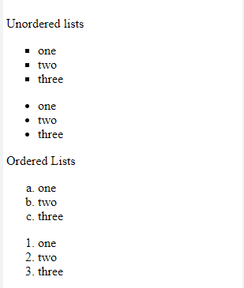
Lists
#3
There are two main types of lists:
unordered lists (<ul>) - the list items are marked with bullets
ordered lists (<ol>) - the list items are marked with numbers or letters
ul.b { list-style-type: square; } ol.c { list-style-type: upper-roman; }

Slide 16
The list-style-image property specifies an image as the list item marker:
ul { list-style-image: url('sqpurple.gif'); }
The list-style-position property specifies the position of the list-item markers (bullet points).
ul.a { list-style-position: outside; } ul.b { list-style-position: inside; }

Slide 17
The list-style-type:none property can also be used to remove the markers/bullets. Note that the list also has default margin and padding. To remove this, add margin:0 and padding:0 to <ul> or <ol>:
ul { list-style-type: none; margin: 0; padding: 0; }
The list-style property is a shorthand property
ul { list-style: square inside url("sqpurple.gif"); }

Slide 18
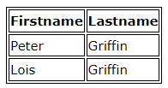
Tables
#4
Can set border for the table, th and td tags using the CSS border property.
table, th, td { border: 1px solid; }
table { width: 100%; }

Slide 19
The border-collapse property sets whether the table borders should be collapsed into a single border
table { border-collapse: collapse; }
If you only want a border around the table, only specify the border
table { border: 1px solid; }

Slide 20
The text-align property sets the horizontal alignment of the content in <th> or <td>.
td { text-align: center; }
The vertical-align property sets the vertical alignment of the content in <th> or <td>.
td { height: 50px; vertical-align: bottom; }

Slide 21
To control the space between the border and the content in a table, use the padding property on <td> and <th> elements
th, td { padding: 15px; text-align: left; }
use the :hover selector on <tr> to highlight table rows on mouse
tr:hover {backgroveround-color: coral;}

Slide 22
The example below specifies the background color and text color of <th> elements:
th { background-color: #04AA6D; color: white; }

Slide 23
Display
#5
The display property is used to specify how an element is shown on a web page.
display: inline;
display: inline-block;
display: block;
display: run-in;
display: none;

Slide 24
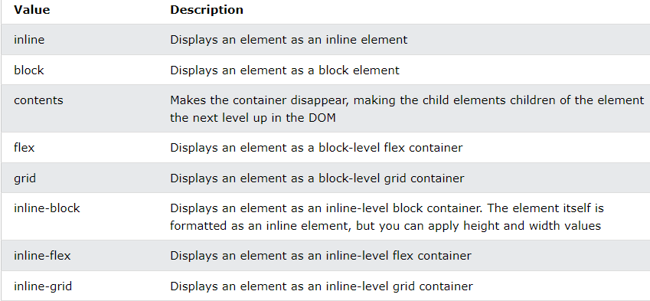

Slide 25
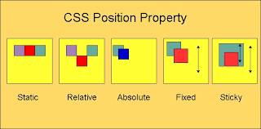
Positions
#6

Slide 26
Static
Relative
HTML elements are positioned static by default.
This <div> element has position: static;
div.static { position: static; border: 3px solid #73AD21; }
An element with position: relative; is positioned relative to its normal position.
This <div> element has position: relative;
div.relative { position: relative; left: 30px; border: 3px solid #73AD21; }

Slide 27
Fixed
Absolute
An element with position: fixed; is always stays in the same place even if the page is scrolled.
div.fixed { position: fixed; bottom: 0; right: 0; width: 300px; border: 3px solid #73AD21; }
An element with position: absolute; is positioned relative to the nearest positioned ancestor
div.absolute { position: absolute; top: 80px; right: 0; width: 200px; height: 100px; border: 3px solid #73AD21; }

Slide 28
Sticky
An element with position: sticky; is positioned based on the user's scroll position..
div.sticky { position: -webkit-sticky; position: sticky; top: 0; background-color: green; border: 2px solid #4CAF50; }

Slide 29
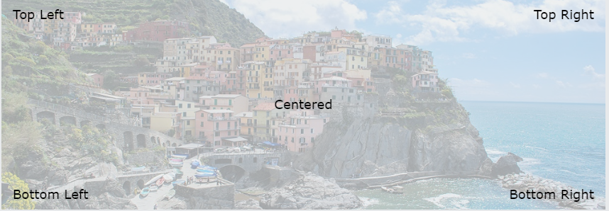
Positioning Text In an Image

Slide 30

Thank you

